Slide 1

Green Pace
Security Policy Presentation
Developer: Shawn Ciaurro
8/17/2025

Slide 2

OVERVIEW: DEFENSE IN DEPTH
Multi Level security
Standardized principles
Use of tools and tests
Universal rules

Slide 3
THREATS MATRIX
Low
Medium
High
 | STD-005-CPP STD-006-CPP STD-007-CPP STD-008-CPP | STD-002-CPP STD-003-CPP STD-004-CPP STD-009-CPP
 |  | STD-001-CPP STD-010-CPP
High
Likelihood
Low
Threat Level

Slide 4
10 PRINCIPLES
Validate Input Data, STD-001, STD-002, STD-003, STD-004, STD-006
Heed Compiler Warnings, STD-001
Architect and Design for Security Policies, STD-005, STD-007, STD-009, STD-010
Keep It Simple, STD-002, STD-009
Default Deny, STD-008
Principle of Least Privilege, STD-005, STD-008, STD-010
Sanitize Data Sent to Other Systems, STD-004, STD-009
Practice Defense in Depth, STD-003, STD-010
Use Effective Quality Assurance Techniques, STD-006, STD-007
Adopt a Secure Coding Standard, all standards applied

Slide 5
CODING STANDARDS
Rule | Severity | Likelihood | Remediation Cost | Priority | Level
STD-009-CPP | High | Likely | Low | High | 5
STD-003-CPP | High | Likely | Medium | High | 5
STD-004-CPP | High | Likely | Low | High | 5
STD-002-CPP | High | Likely | Low | High | 4
STD-010-CPP | High | Unlikely | Medium | High | 4
STD-005-CPP | Medium | Likely | Medium | Medium | 3
STD-006-CPP | Medium | Likely | Low | Medium | 3
STD-007-CPP | Medium | Likely | Low | Medium | 3
STD-008-CPP | Medium | Likely | Low | Medium | 3
STD-001-CPP | High | Unlikely | Medium | High | 2
STD-009 — Limit Use of System Calls and Shell Execution
STD-003 — Proper String Handling to Avoid Buffer Overflows
STD-004 — Parameterized Queries to Prevent SQL Injection
STD-002 — Check Data Values Before Use
STD-010 — Clear Out Sensitive Data After Use
STD-005 — Prevent Memory Leaks & Handle Freed Memory
STD-006 — Enforce Preconditions & Invariants with Assertions
STD-007 — Use Targeted Exception Catching
STD-008 — Close Files & Free Resources
STD-001 — Use Appropriate Data Types for Variable Intent

Slide 6
ENCRYPTION POLICIES
Encryption at Rest
Stored Data
Data bases
Hard Drives
Cloud storage
Files
Encryption in Flight
Data moving between systems
Login forms
VPNs
Secure Shells
API Traffic
Secure messaging
Encryption in Use
RAM
Clear sensitive data from memory

Slide 7
TRIPLE-A POLICIES
Authentication – Verifying user identity
Require multi-factor authentication (MFA)
Require strong passwords
Enforce single sign-on session
Authorization – Controlling the user's access
Role-based access control
Least privilege rule
Review new roles and elevated permissions
Accounting – Auditing and tracking activity
Keep detailed logs of user activity and access
Automated alerts
Regular log audits

Slide 8
Unit Testing
Unit testing is using single functions to verify that the output for some processed input is what is expected.
In the following slides, it will be demonstrated how test can keep to our standards using:
STD-002 — Check Data Values Before Use
Using fun, pirate themed test examples, we will see the use of tests to check values and avoid vulnerabilities.

Slide 9
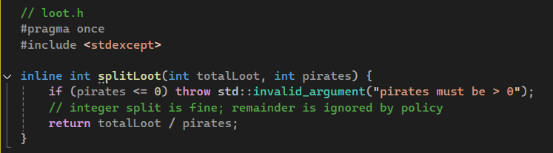

Function to be Tested
The following function is used to split the loot collected by pirates depending on the amount of loot and pirates in the crew.
This must be tested to avoid logic errors and vulnerabilities.

Slide 10
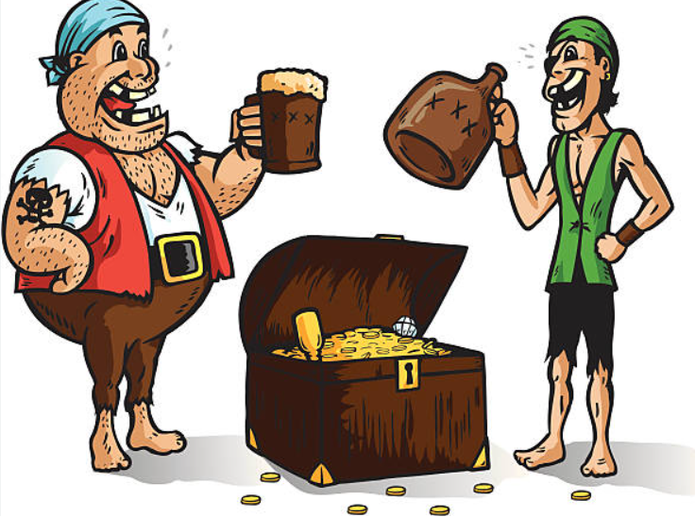
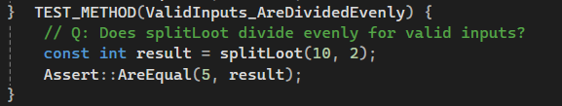
Test 1: Sanity Check
Functionality based test
Is the logic right?

Slide 11

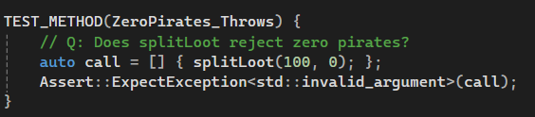
Test 2: Divide by Zero
Checks that you cannot divide by 0.
Passes if exception thrown

Slide 12

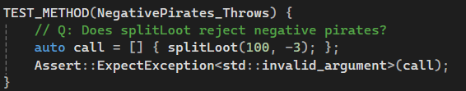
Test 3: No Negative Pirates
Ensures an exception is thrown when negative value is input for number of pirates.

Slide 13
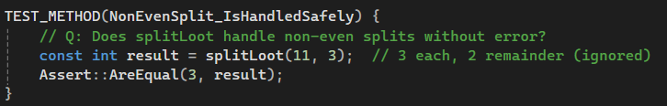
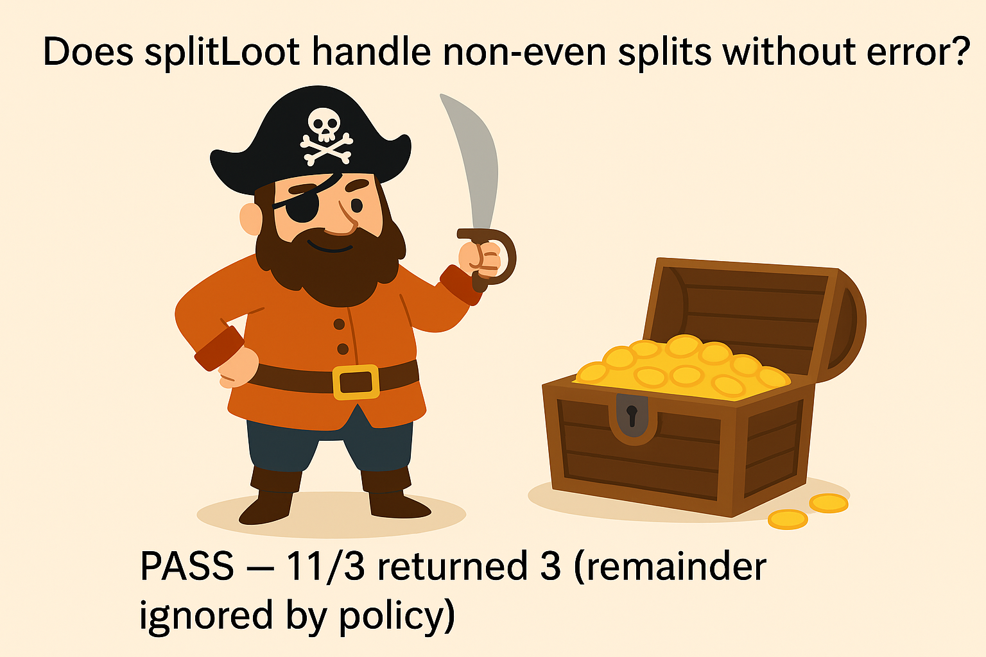
Test 4: Handling Uneven Split
The function is made to ignore the remainder.
Checks that no error occurs in uneven situations

Slide 14

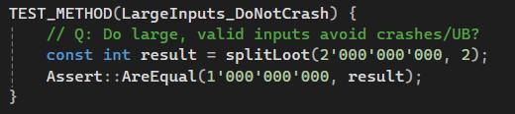
Test 5: Large inputs
Ensures the function handles large inputs without crashing

Slide 15

AUTOMATION SUMMARY

Slide 16
DevSecOps Pipeline & Tools
Plan – Threat modeling; define secure coding policies
Code – IDE plugins, Cppcheck, Clang-Tidy for early feedback
Build – Compiler warnings-as-errors; SonarQube SAST scans
Test – Unit tests, Valgrind, Fortify SCA (dynamic analysis)
Release – Container/IaC scans; artifact signing
Operate – Runtime monitoring, WAF shields, auto-rollback

Slide 17
RISKS AND BENEFITS
Problems | Input validation gaps | Memory/ resource leaks | Sensitive data left in memory | Over-reliance on manual review
Solutions | Enforce validation, sanitization, and safer APIs | Use automated tools | Clear sensitive data and adopt least-privilege design | Automate compliance in DevSecOps pipeline

Slide 18
RISKS AND BENEFITS
(cont.)
Risks of waiting: – Higher chance of breach/data loss – Costly fixes if vulnerabilities are found late – Non-compliance penalties (legal/regulatory) – Loss of trust and reputation
Benefits of acting now: – Reduced attack surface – Lower remediation cost through “shift-left” security – Stronger compliance and audit readiness – Builds user and client confidence

Slide 19
STRATEGY SHORTCOMINGS & RECOMMENDATIONS
Where strategy lacks:
Runtime protections still limited
e.g. Equifax Breach of 2017
Some tools not integrated across all environments
Human error still a factor without stricter enforcement
e.g. Capital One Breach of 2019
Steps to take:
Expand runtime monitoring & incident response
Increase automation coverage in CI/CD pipeline Conduct regular access reviews and threat modeling
Provide developer training on secure coding

Slide 20
CONCLUSIONS
Security should be part of the entire process, not an afterthought.
Automation and tools
Trust the policy

Slide 21
REFERENCES
Fier, J. (2019, August 6). Lessons from the Capital One breach on cloud security. Darktrace. https://www.darktrace.com/blog/back-to-square-one-the-capital-one-breach-proved-we-must-rethink-cloud-security
Belfer Center. (2021, June 15). Equifax data breach. Belfer Center for Science and International Affairs. https://www.belfercenter.org/publication/equifax-data-breach
Linford & Company LLP. (2022, February 28). Information security policies: Why you need them and 8 examples. Linford & Company. https://linfordco.com/blog/information-security-policies/
Developer Insider. (2016, August 28). Simple and static assertion (assert) in C programming language. Developer Insider. http://developerinsider.co/simple-and-static-assertion-assert-in-c-programming-language/
DORA. (2024, May 24). Shifting left on security. DevOps Research and Assessment (DORA). In DevOps capabilities. Internet Archive. https://web.archive.org/web/20240524180526/https://dora.dev/devops-capabilities/process/shifting-left-on-security/

